Slide 1
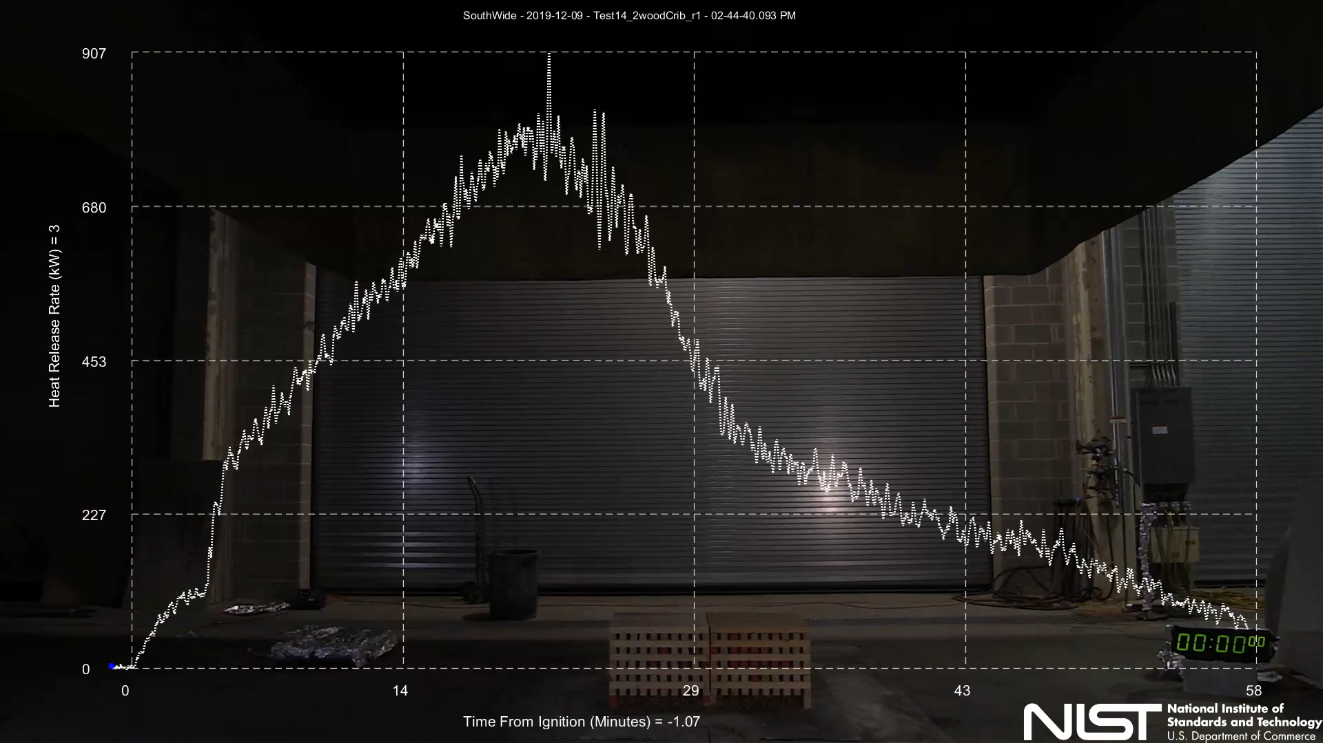
Ensemble Learning for Fire Calorimetry Database
Team Fire Fighters : Ekanki, Srish, Bhaskar, Kuldeep
Instructors : Pavlos Protopapas & Ignacio Becker
TAs : Arya, Kshitij, Sakthisree, Yashraj
Univ.AI DS 2 Final Project
Peak Heat Release Rate
Heat Release Rate (kW)
Fire Calorimetry Database https://www.nist.gov/el/fcd)
Time to Peak Heat Release Rate
Univ.AI
Time From Ignition (minutes)

Slide 2
Ensemble Learning for Fire Calorimetry Database : Project Goals
Data Augmentation using Aleatoric Uncertainty : Ekanki
How can we use the measurement uncertainty to augment the data?
Can ML techniques help in reducing the measurement uncertainty?
Anomaly / Outlier Detection: Kuldeep
Can ensemble techniques (Isolation Forest, Feature Bagging) detect anomalies.
Comparison with linear methods: PCA, SVM
Proximity based techniques : kNN, Local Outlier Factor (LCF), Histogram (HBOS)
Neural networks (Fully Connected AutoEncoders)
3. Regression : Interpretability / Model Evaluation: Srish
Can ensemble methods identify local / global features that affect a response variable
4. Clustering analysis / Ensemble Techniques: Bhaskar
Streamlit App for Automation / Evaluation - Srish

Slide 3
Data Augmentation using Aleatoric Uncertainty
Data Augmentation:
To deal with small size of development data, data augmentation was performed using aleatoric uncertainty.
Gaussian approximation of features was used for sampling data with 95% confidence interval.
Correlation matrices of augmented and original datasets were compared.
Modelling Approach:
Linear / Logistic regression, Decision tree, Random Forest and Gradient Boosting algorithms were explored on both augmented as well as original data.

Slide 4
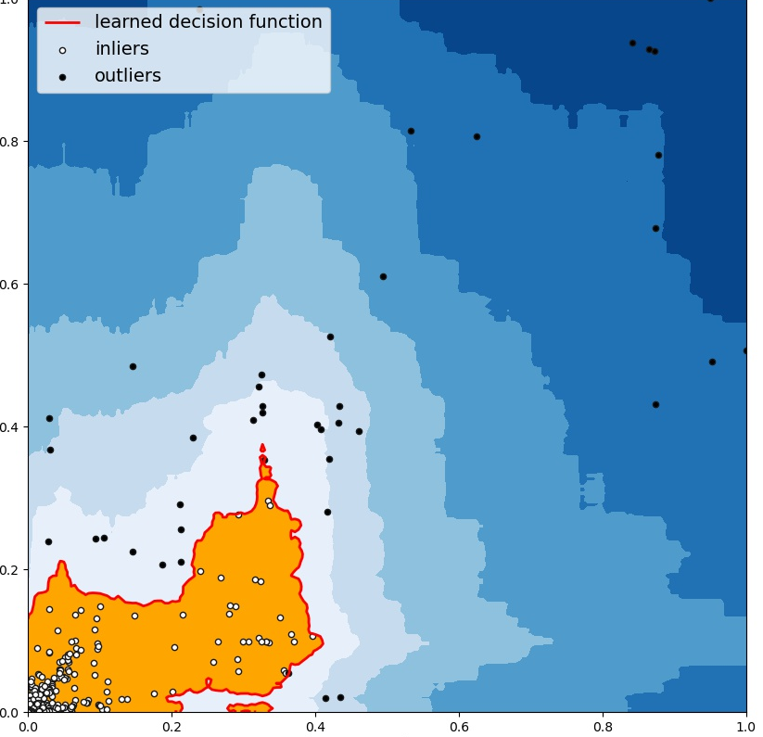
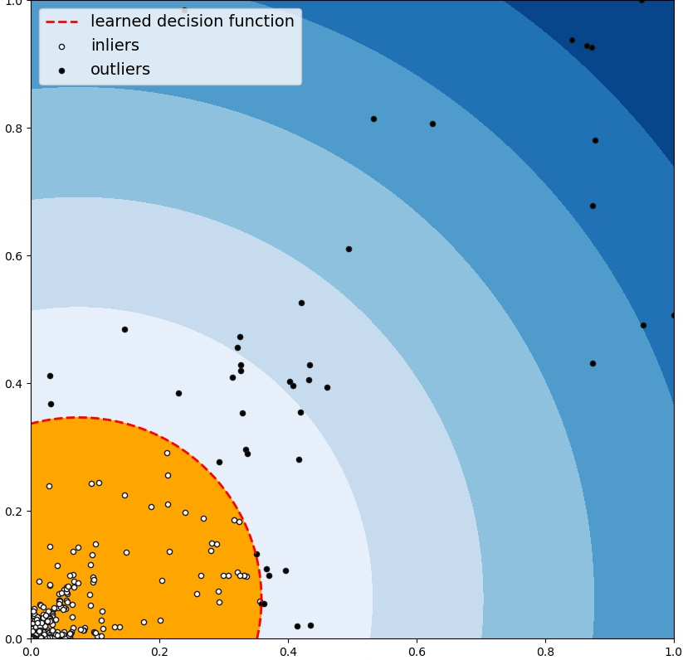
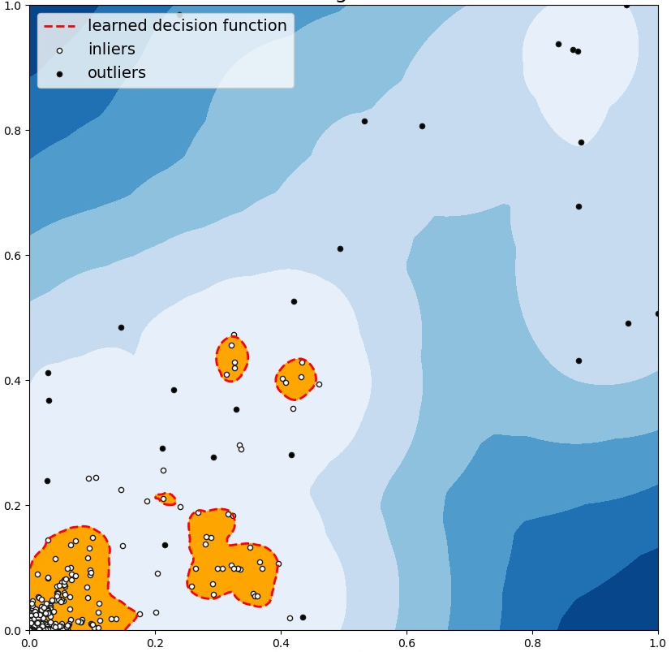
1) Outlier Ensembles, C Aggarwal, S Sathe, Springer 2017
2) PyOD: A python toolbox for scalable outlier detection, Journal of Machine Learning 20 (2019) 1-7.
Fire Calorimetry Database
Tabular Data (JSON file from AWS)
Outlier Ensembles
-Isolation Forest
-Feature Bagging
-Extreme Boosting
Neural Networks
-Autoencoders
-Variational Auto-Encoders (VAE)
Linear Models
-PCA
-Support Vector
Machines (SVM)
Proximity Based
-kNN, AvgkNN, MedkNN
-Histogram Based Score
-Local Outlier Factor (LOF)
Probabilistic
-ABOD
-Fast ABOD
-Stochastic OD
Iterative Approach
Normalized Feature 2
Normalized Feature 1
Outlier Anomaly Score / Aggregation¹
Remove Outliers²

Slide 5
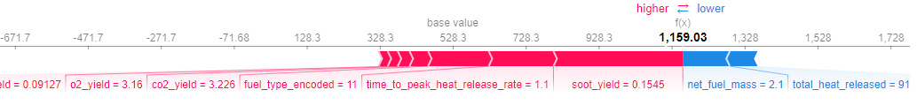
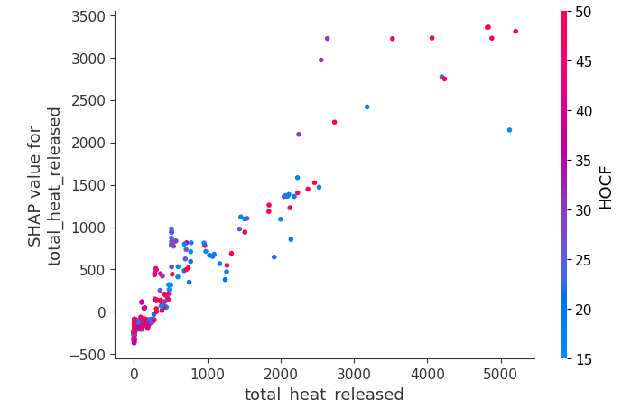
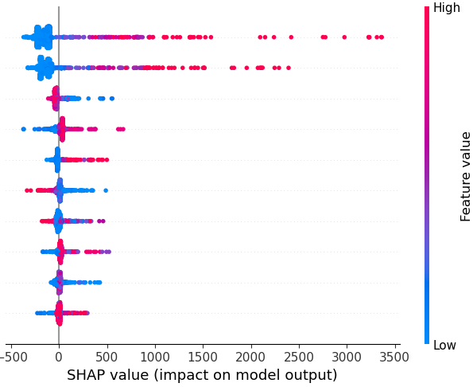
Interpretation Learning (Shap Value and Lime) Regression Analysis (Ensemble methods) to Predict Peak Heat Release
Total Heat Released
Net Fuel Mass
Fuel Type
CO2 yield
Soot yield
Time to Peak
Test Duration
O2 Yield
CO Yield
HOCF
Shap Value for
Total Heat Released
Total Heat Released
SHAP Value (Impact on Model Output)

Slide 6
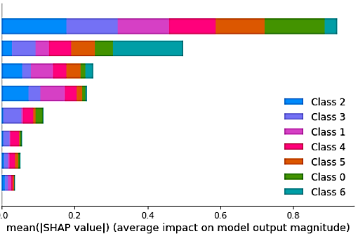
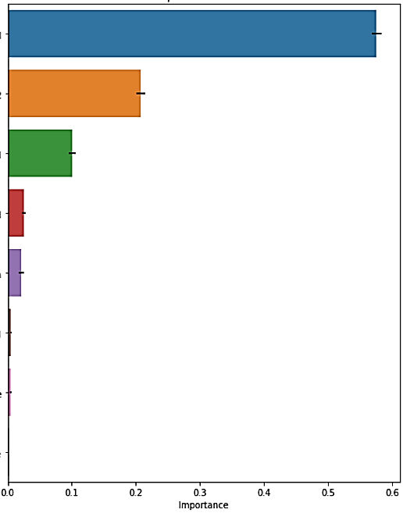
Can we Identify the Fuel that was Burnt? What are the important Features?
Fire Calorimetry Database
Drop negative yield values
Exploratory Data Analysis Missing Value Imputation Remove Correlated Features
Feature Engineering
heat of combustion / fuel (HOCf)
heat of combustion / O2 (Ef)
Label Encoding
Baseline :
Logistic Regression
Tree Based Models:
Decision Tree
Bagging Classifier
Random Forest
AdaBoostClassifier
Baseline Performance:
Train Accuracy: 97%
Test Accuracy: 88%
Best Model: RF
Train Accuracy: 100%
Test Accuracy: 98%
Hyperparameter Tuning GridSearchCV
Class Imbalance in Train Data: Up-sampled Minority Class using SMOTE
Data Augmentation Stratified Train-Test Split
Permutation Feature Importance
Global Feature Importance using Shapley Values
Use Cases
Detection of constituent elements of a product. For example: adulteration of plastics in food products
Arson fires
HOCf
HOCf
Ef
Ef
Total Heat Released
Test Duration
Soot Yield
Total Heat Released
Soot Yield
Test Duration
PHRR
CO Yield
CO Yield
PHRR
Time to PHRR
Time to PHRR
Both original & augmented dataset yielded that HOCf and Ef are the most important features.

Slide 7
Conclusions, Future Work and IMPACT
Ensemble models : Successful in estimating the integrated values of Peak Heat Release Rate as well as classifying Fuel Type.
Isolation Forest / Bagging used successfully for Anomaly Detection.
Interpretation Learning is very helpful in understanding the models.
Continue the project as part of on-going research activities.
Extension for data augmented videos and time-dependent output.
Streamlit App Demonstration - Srish

